Slide 1


The Impact of Malnutrition on Clinical Outcomes in Patients Diagnosed with COVID-19
ASPEN 2022 Nutrition Science & Practice Conference
Jana Ponce, PhD RD LMNT
Assistant Professor
University of Nebraska Medical Center, Omaha, NE

Slide 2
Disclosures
No commercial relationships to disclose

Slide 3
Learning Objectives
Upon completion of this presentation, the learner will be able to:
Describe the prevalence of malnutrition in patients hospitalized with COVID-19 in a large United States (US) sample
Describe the impact of pre-existing malnutrition on mortality and adverse hospital events in patients hospitalized with COVID-19
Describe the impact of hospital-acquired malnutrition on mortality and adverse hospital events in patients hospitalized with COVID-19
Notes:
Following this presentation, learners will be able to:
Describe the prevalence of malnutrition in patients hospitalized with COVID-19 in the United States
Describe the impact of pre-existing malnutrition on mortality and adverse hospital events AND
Describe the impact of hospital-acquired malnutrition on mortality and adverse events in patients hospitalized with COVID-19

Slide 4
Background and Aims

Slide 5
Background and Relevance
COVID-19 Pandemic
476 million cases and 6 million deaths
Malnutrition
Weaker immune responses¹
Poor diaphragmatic and respiratory function²
Hypothesis
A history of malnutrition or becoming malnourished during hospitalization is associated with increased mortality and poor clinical outcomes in patients hospitalized with COVID-19 in the US
1. Chandra RK. Rosette-forming T lymphocytes and cell-mediated immunity in malnutrition. Br Med J. Sep 7 1974;3(5931):608-9. doi:10.1136/bmj.3.5931.608
2. Ferrari-Baliviera E, Pierdominici S, Sarcinelli L. [Effects of the nutritional status on the respiratory system]. Minerva Anestesiol. Nov 1989;55(11):443-50. Influenza dello stato nutrizionale sull'apparato respiratorio.
Notes:
The COVID-19 pandemic has swept the globe in the past two years with over 476 million cases and over 5 million deaths world-wide
Given that malnutrition is associated with weaker immune responses and poor diaphragmatic and respiratory function we can assume that individuals with a history of malnutrition, possibly due to chronic disease or chronic starvation, may be more susceptible to poor outcomes during COVID-19 infection
On the other hand, those without underlying malnutrition have a high risk of becoming acutely malnourished during hospital admission due to symptoms of COVID-19 such as anorexia, nausea, vomiting and hypermetabolism.
With this in mind, our research team hypothesized that a with history of malnutrition or becoming malnourished during hospitalization is associated with increased mortality and poor clinical outcomes in patients hospitalized with COVID-19

Slide 6
Study Rationale
1. Limited data are available assessing prevalence of malnutrition in patients hospitalized with COVID-19 in the US
2. No US studies assessing the impact of malnutrition on outcomes in patients hospitalized with COVID-19
3. Differential effects of pre-existing versus hospital-acquired malnutrition in patients hospitalized with COVID-19 has not been investigated
Notes:
Although previous studies explored the relationship of nutrition risk and malnutrition in patients hospitalized with COVID-19, we have identified 3 gaps in current knowledge:
First, limited US data are available assessing prevalence of malnutrition in patients hospitalized with COVID-19
Second, no US studies have assessed the impact of malnutrition on outcomes in this patient population and
Third, the differential effects of pre-existing versus hospital-acquired malnutrition on outcomes in patients hospitalized with COVID-19 hasn’t been investigated

Slide 7
Study Aims
Specific Aim 1:
Identify the prevalence of pre-existing and hospital-acquired malnutrition in patients hospitalized with COVID-19 in a large US cohort
Specific Aim 2:
Determine the association between pre-existing malnutrition on mortality and adverse hospital events in patients hospitalized with COVID-19 in the US
Specific Aim 3:
Determine the association of hospital-acquired malnutrition on mortality and adverse hospital events in patients hospitalized with COVID-19 in the US
Notes:
With these gaps in mind, our research team developed the following study aims:
Our first aim was to identify the prevalence of patients with pre-existing and hospital-acquired malnutrition in patients hospitalized with COVID-19 in the US
Second, we aimed to determine the association between pre-existing malnutrition on mortality and adverse hospital events in this patient population
And our third aimed was to determine the association of hospital-acquired malnutrition on mortality and adverse hospital events

Slide 8
Methods

Slide 9

Study Design
Retrospective Cohort
National COVID Cohort Collaborative (N3C)³
Developed by the NIH
Longitudinal Electronic Health Records
Data Partners across the US
Final data extraction: Dec 2, 2021
Release 55
3. Haendel MA, Chute CG, Bennett TD, et al. The National COVID Cohort Collaborative (N3C): Rationale, design, infrastructure, and deployment. J Am Med Inform Assoc. Mar 1 2021;28(3):427-443. doi:10.1093/jamia/ocaa196
Notes:
This retrospective cohort utilized longitudinal data from the National COVID Cohort Collaborative database, also known as N3C.
The N3C was developed by the NIH and systematically collects regularly updated data derived from electronic health records of patients that were tested for COVID-19 or had a diagnosis of COVID-19 from a provider
Data partners include contributing institutions encompassing multiple providers and multiple sites of care across the United States
Our final data extraction utilized data from release 55 and occurred on December 2, 2021

Slide 10
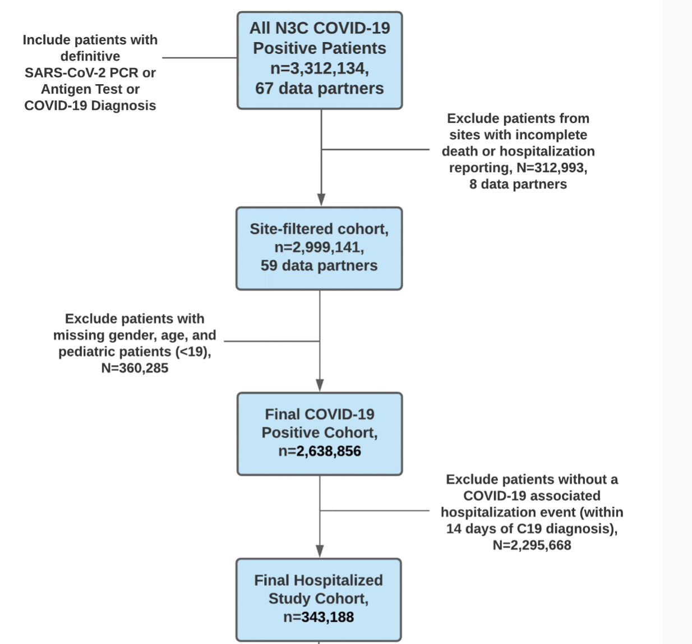
Inclusion/Exclusion Criteria
Notes:
The figure included on this slide highlights our inclusion and exclusion criteria and how we arrived at our final hospitalized cohort.
At the top of the figure in the first blue box, you can see we started by including all patients with a definitive COVID-19 diagnosis
Moving from top to bottom, we then excluded:
– patients from sites with incomplete death or hospitalization reporting
– patients with missing gender or age along with pediatric patients under the age of 19 and finally
– patients without a COVID-19 associated hospitalization within 14 days of diagnosis.
Leaving us with the final hospitalized study cohort at the bottom

Slide 11
Primary Exposure: Malnutrition
Defined as the presence of one or more of the following ICD-10 diagnostic codes within the medical record:
Severe protein-calorie malnutrition
Malnutrition of a moderate degree
Moderate protein energy malnutrition
Moderate protein-calorie malnutrition
Mild protein-calorie malnutrition
Malnutrition of a mild degree
Malnutrition following gastrointestinal surgery
Starvation
Semi-starvation
Undernutrition
Deficiency of macronutrients
Nutritional deficiency disorder
Nutritional wasting
Wasting disease
Marasmic Kwashiorkor
Kwashiorkor
History of Malnutrition
Malnutrition diagnosed prior to COVID-19 Infection
Hospital-Acquired Malnutrition
Malnutrition diagnosed on or after COVID-19 Infection
Notes:
Malnutrition served as the primary exposure in this study and was defined by the presence of one or more of the 16 selected ICD-10 diagnostic codes within the hospitalized patient’s medical record.
Patients with malnutrition diagnosed prior to COVID-19 infection were classified as having a History of Malnutrition while
Patients with malnutrition diagnosed on or after COVID-19 infection were classified as having Hospital-Acquired Malnutrition

Slide 12
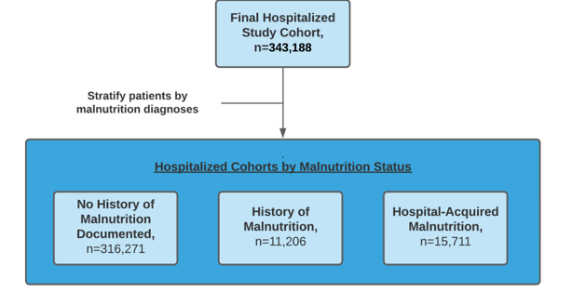
Patients Categorized into Malnutrition Groups
Notes:
Patients included in the final hospitalized cohort were then stratified into three malnutrition groups for analysis.
The first group includes patients with no documented history of malnutrition
The second includes those with a history of malnutrition and
The third and final group includes patients with hospital-acquired malnutrition

Slide 13
Outcomes
Mortality
Death or transfer to hospice
Adverse Hospital Events
Mechanical Ventilation
Acute Respiratory Distress Syndrome (ARDS)
Extra-Corporeal Membrane Oxygenation (ECMO)
Hospital-Acquired Pressure Injury (HAPI)
Notes:
The primary outcome of this study was mortality, defined as an ICD-10 code of death or transfer to hospice during COVID-19 hospitalization.
Secondary outcomes, also defined as presence of an ICD-10 codes within the medical record, included the following adverse hospital events:
Mechanical ventilation
Acute respiratory distress syndrome (ARDS)
Extra-corporeal membrane oxygenation (ECMO) and
Hospital-acquired pressure injuries (HAPI) at any time during hospitalization.

Slide 14

Statistical Analysis
Frequencies and percentages of demographic and clinical characteristics
Wilcoxon rank-sum: malnutrition groups and continuous measures
Chi-squared: malnutrition groups and categorical variables
Logistic regression models with adjustment: malnutrition and mortality and adverse hospital events
Age, sex, race/ethnicity, Charlson Comorbidity Index (CCI), smoking status.
Notes:
Frequencies and percentages of demographic and clinical characteristics between the no documented history of malnutrition, history of malnutrition, and hospital-acquired malnutrition groups were calculated
Groups were then compared using either the Wilcoxon rank-sum tests for continuous measures or Chi-Square test for categorical variables
Finally, univariate and multivariable logistic regression models were used to evaluate odds ratios of mortality and adverse hospital events based on malnutrition group.
Adjusted models were controlled for age, sex, race/ethnicity, Charlson comorbidity index and smoking status.
These confounders were determined a priori using directed acyclical graphing, knowledge of clinical relationships and relevant literature.
A p value of <0.05 was considered statistically significant.

Slide 15
Results

Slide 16

Prevalence of Malnutrition in Patients Hospitalized with COVID-19 in a US Cohort
343,188 Patients Hospitalized with COVID-19
92.1%
3.3%
4.6%
Notes:
We’ll start by discussing the prevalence of malnutrition in patient hospitalized with COVID-19 in a United States Cohort
Our final hospitalized study cohort included over 340,000 patients.
In the map of the US on the left-hand side of the slide, you can see the geographic distribution of these patients across the country
Moving to the right-hand side of the slide which shows the final hospitalized cohort stratified by the malnutrition groups,
92% of patients had no documented history of malnutrition,
Over 11,000 (or 3.3%) had a history of malnutrition and
Over 15,000 patients (or 4.6%) had hospital-acquired malnutrition.
Overall, 7.9% of the final hospitalized cohort had a diagnosis of malnutrition.

Slide 17
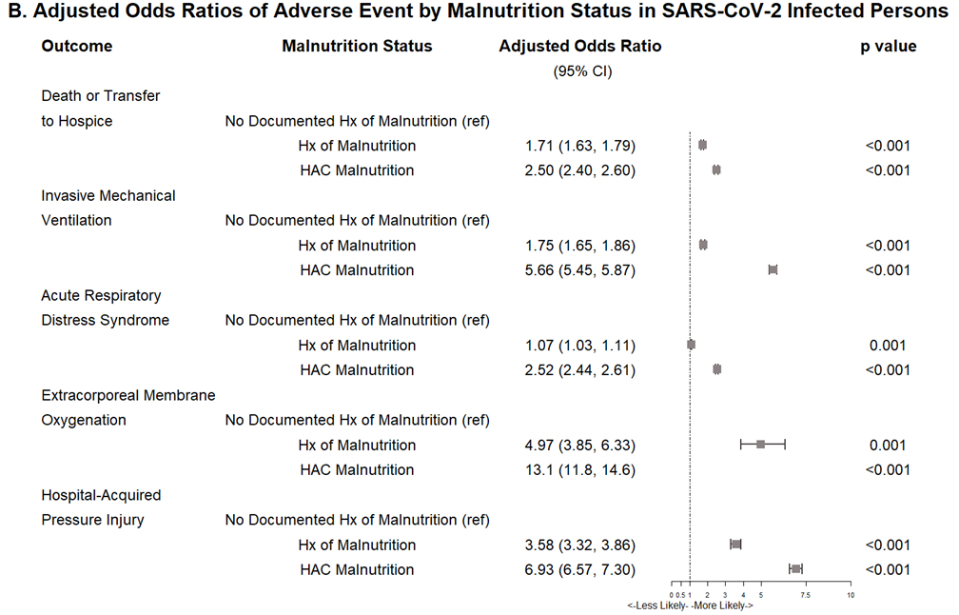
Results: Multivariable Logistic Regression
*Adjusted for age, sex, race/ethnicity, CCI and smoking status
HAC: Hospital-Acquired Malnutrition
Notes:
Following adjustment for age, sex, race/ethnicity, CCI and smoking status, results remained statistically significant for each outcome of interest
-Odds of death or transfer to hospice were 1.7 times higher in patients with a history of malnutrition and 2.5 times higher in those with hospital-acquired malnutrition
-In the same respect, odds of mechanical ventilation were approximately 1.8 times higher in those with a history of malnutrition and 5.7 times higher in those with hospital-acquired malnutrition
-Having a history of malnutrition increased odds of Acute Respiratory Distress Syndrome by approximately 1.1 times and hospital-acquired malnutrition increased the odds by 2.5 times
-Odds of ECMO were approximately 5 times higher in patients with a history of malnutrition and 13 times higher in those with hospital-acquired malnutrition and finally
-Odds of hospital-acquired pressure injury were 3.6 times higher in those with a history of malnutrition and approximately 7 times higher in those with hospital-acquired malnutrition

Slide 18
Discussion and Conclusion

Slide 19
Strengths and Limitations
Strengths
First study examining a large US cohort of adult patients hospitalized with COVID-19
Prevalence of malnutrition
Impact of malnutrition on mortality and adverse hospital events
Elucidates variances in outcomes between patients with a history of- or hospital acquired malnutrition
Limitations
Retrospective data
Use of ICD-10 diagnostic codes rather than AND/ASPEN criteria
Notes:
To the best of our knowledge, this is the first study examining a large US cohort of patients hospitalized with COVID-19 to evaluate the following:
First, the prevalence of malnutrition in adult hospitalized patients with COVID-19 in the US
Second, the impact of malnutrition on mortality and adverse hospital events in patients hospitalized with COVID-19 and
Third the variances in outcomes between hospitalized COVID-19 patients with a history of malnutrition and hospital-acquired malnutrition
This research is limited by its use of retrospective data and the reliance on ICD-10 diagnostic codes rather Academy of Nutrition and Dietetics and ASPEN guidelines which is considered the standard of care for identifying and diagnosing malnutrition
While these limitations are acknowledged, the N3C database is currently the most representative sample of patients with COVID-19 in the United States, making its use appropriate for this research.

Slide 20




Major Findings
Patients with malnutrition who were hospitalized with COVID-19
2.5x more likely to die
5.7x more likely to require mechanical ventilation
13x more likely to require ECMO support
6.9x more likely to develop a HAPI
Notes:
Our major findings show that patients with malnutrition who were hospitalized with COVID-19 were
2.5x more likely to die
5.7x more likely to require mechanical ventilation
13x more likely to require ECMO support

Slide 21
Conclusion
Early and frequent nutrition assessments to ensure accurate malnutrition diagnosis by the interdisciplinary team
Targeted interventions could improve outcomes in patients hospitalized with COVID-19
Notes:
In Conclusion,
This study highlights the importance of early and reoccurring nutrition assessments to ensure accurate malnutrition dx by the interdisciplinary team.
The identification of patients with malnutrition allows for targeted interventions which could improve outcomes in patients hospitalized with COVID-19

Slide 22
Acknowledgements
Jerrod Anzolone, MS
Kristina Bailey, MD
Harlan Sayles, MS
Megan Timmerman, MPA RD
Mariah Jackson, MMN RD
James McClay, MD MS
Corrine Hanson, PhD RD

Slide 23
References
1. Chandra RK. Rosette-forming T lymphocytes and cell-mediated immunity in malnutrition. Br Med J. Sep 7 1974;3(5931):608-9. doi:10.1136/bmj.3.5931.608
2. Ferrari-Baliviera E, Pierdominici S, Sarcinelli L. [Effects of the nutritional status on the respiratory system]. Minerva Anestesiol. Nov 1989;55(11):443-50. Influenza dello stato nutrizionale sull'apparato respiratorio.
3. Haendel MA, Chute CG, Bennett TD, et al. The National COVID Cohort Collaborative (N3C): Rationale, design, infrastructure, and deployment. J Am Med Inform Assoc. Mar 1 2021;28(3):427-443. doi:10.1093/jamia/ocaa196

Slide 24
Thank you
Questions?

